Slide 1
Chapter 4: Threads

Slide 2
Motivation
Most modern applications are multithreaded
Threads run within application
Multiple tasks with the application can be implemented by separate threads
Update display
Fetch data
Spell checking
Answer a network request
Process creation is heavy-weight while thread creation is light-weight
Can simplify code, increase efficiency
Kernels are generally multithreaded

Slide 3
Multithreaded Server Architecture

Slide 4
Benefits
Responsiveness – may allow continued execution if part of process is blocked, especially important for user interfaces
Resource Sharing – threads share resources of process, easier than shared memory or message passing
Efficiency – faster than process creation, thread switching lower overhead than context switching
Scalability – process can take advantage of multiprocessor architectures

Slide 5
Multicore Programming
Multicore or multiprocessor systems putting pressure on programmers, challenges include:
Dividing activities
Balance
Data splitting
Data dependency
Testing and debugging
Parallelism implies a system can perform more than one task simultaneously
Concurrency supports more than one task making progress
Single processor / core, scheduler providing concurrency

Slide 6
Multicore Programming (Cont.)
Types of parallelism
Data parallelism – distributes subsets of the same data across multiple cores, same operation on each
Task parallelism – distributing threads across cores, each thread performing unique operation
As # of threads grows, so does architectural support for threading
CPUs have cores as well as hardware threads
Consider Oracle SPARC T4 with 8 cores, and 8 hardware threads per core

Slide 7
Concurrency vs. Parallelism
Concurrent execution on single-core system:
Parallelism on a multi-core system:

Slide 8
Single and Multithreaded Processes

Slide 9
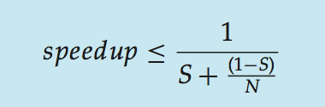
Amdahl’s Law
Identifies performance gains from adding additional cores to an application that has both serial and parallel components
S is serial portion
N processing cores
That is, if application is 75% parallel / 25% serial, moving from 1 to 2 cores results in speedup of 1.6 times
As N approaches infinity, speedup approaches 1 / S
Serial portion of an application has disproportionate effect on performance gained by adding additional cores
But does the law take into account contemporary multicore systems?

Slide 10
User Threads and Kernel Threads
User threads - management done by user-level threads library
Three primary thread libraries:
POSIX Pthreads
Windows threads
Java threads
Kernel threads - Supported by the Kernel
Examples – virtually all general purpose operating systems, including:
Windows
Solaris
Linux
Tru64 UNIX
Mac OS X

Slide 11
Multithreading Models
Many-to-One
One-to-One
Many-to-Many

Slide 12
Many-to-One
Many user-level threads mapped to single kernel thread
One thread blocking causes all to block
Multiple threads may not run in parallel on muticore system because only one may be in kernel at a time
Few systems currently use this model
Examples:
Solaris Green Threads
GNU Portable Threads

Slide 13
One-to-One
Each user-level thread maps to kernel thread
Creating a user-level thread creates a kernel thread
More concurrency than many-to-one
Number of threads per process sometimes restricted due to overhead
Examples
Windows
Linux
Solaris 9 and later

Slide 14
Many-to-Many Model
Allows many user level threads to be mapped to many kernel threads
Allows the operating system to create a sufficient number of kernel threads
Solaris prior to version 9
Windows with the ThreadFiber package

Slide 15
Two-level Model
Similar to M:M, except that it allows a user thread to be bound to kernel thread
Examples
IRIX
HP-UX
Tru64 UNIX
Solaris 8 and earlier

Slide 16
Thread Libraries
Thread library provides programmer with API for creating and managing threads
Two primary ways of implementing
Library entirely in user space
Kernel-level library supported by the OS

Slide 17
Pthreads
May be provided either as user-level or kernel-level
A POSIX standard (IEEE 1003.1c) API for thread creation and synchronization
Specification, not implementation
API specifies behavior of the thread library, implementation is up to development of the library
Common in UNIX operating systems (Solaris, Linux, Mac OS X)

Slide 18
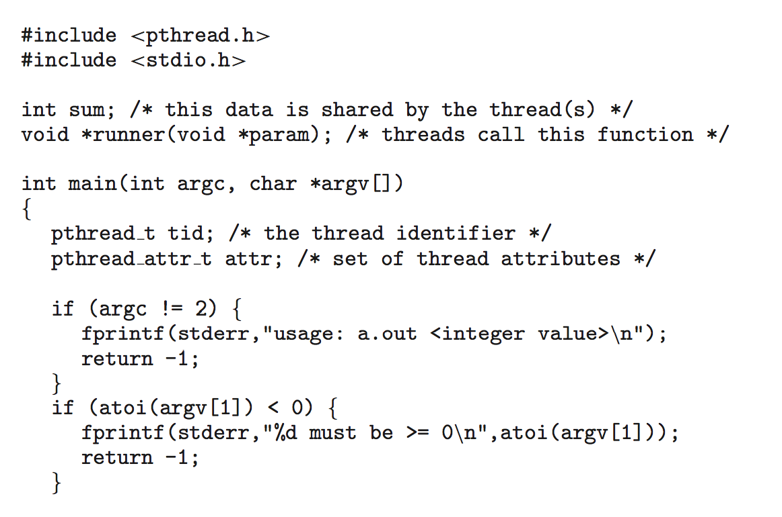
Pthreads Example

Slide 19
Pthreads Example (Cont.)

Slide 20
Pthreads Code for Joining 10 Threads

Slide 21
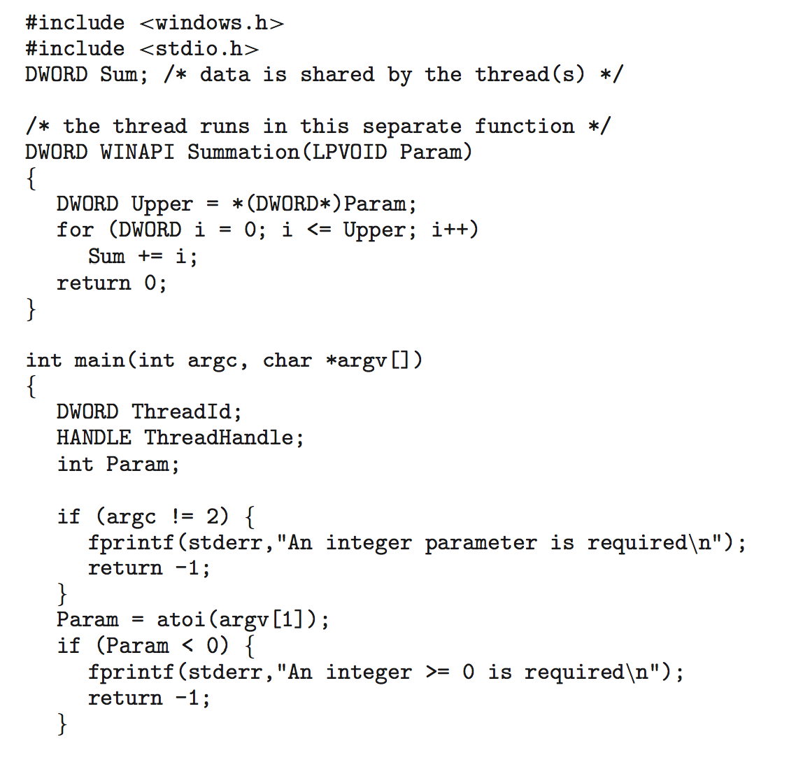
Windows Multithreaded C Program

Slide 22
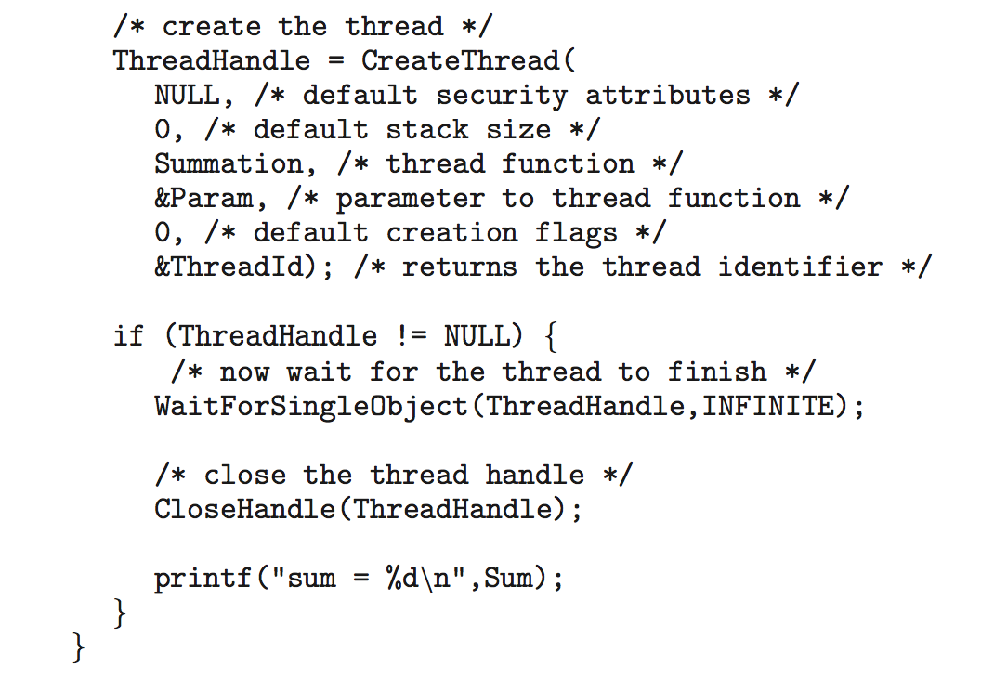
Windows Multithreaded C Program (Cont.)

Slide 23
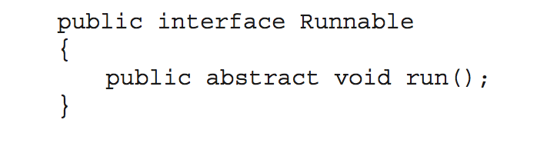
Java Threads
Java threads are managed by the JVM
Typically implemented using the threads model provided by underlying OS
Java threads may be created by:
Extending Thread class
Implementing the Runnable interface

Slide 24
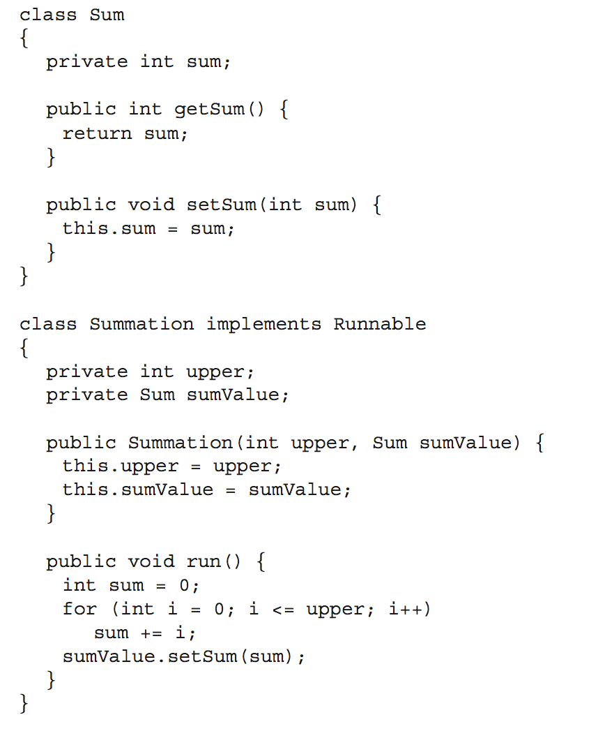
Java Multithreaded Program

Slide 25
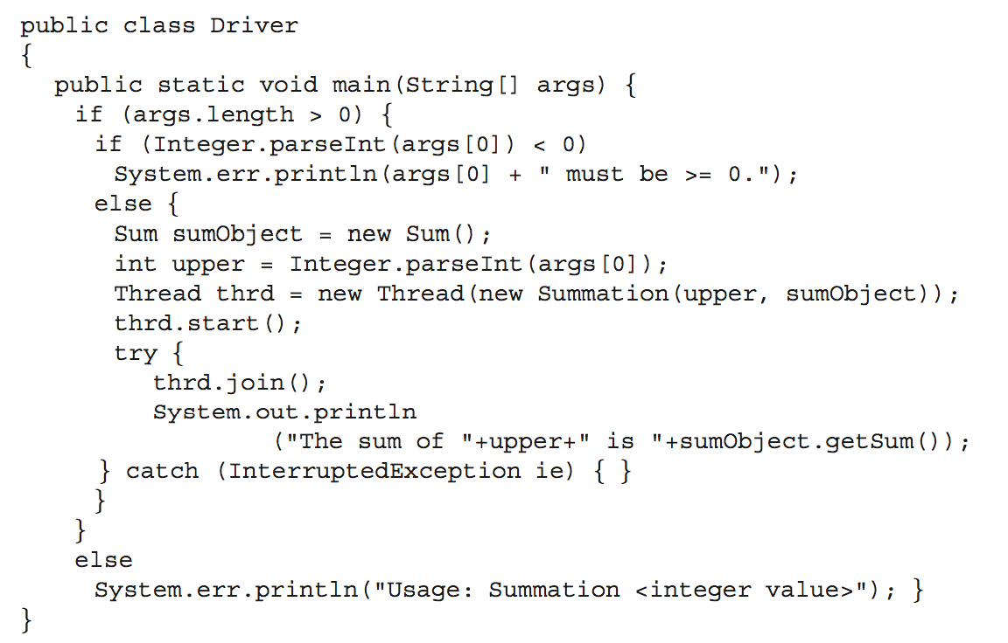
Java Multithreaded Program (Cont.)

Slide 26
Implicit Threading
Creation and management of threads done by compilers and run-time libraries rather than programmers
Three methods explored
Thread Pools
OpenMP
Grand Central Dispatch
Other methods include Microsoft Threading Building Blocks (TBB), java.util.concurrent package

Slide 27
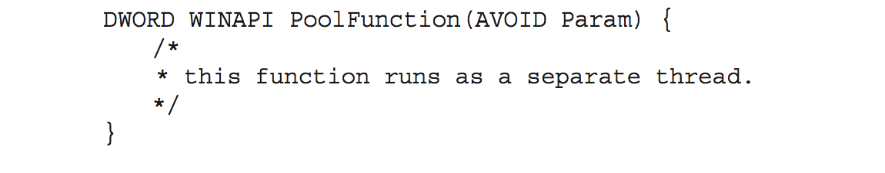
Thread Pools
Create a number of threads in a pool where they await work
Advantages:
Usually slightly faster to service a request with an existing thread than create a new thread
Allows the number of threads in the application(s) to be bound to the size of the pool
Separating task to be performed from mechanics of creating task allows different strategies for running task
i.e.Tasks could be scheduled to run periodically
Windows API supports thread pools:

Slide 28
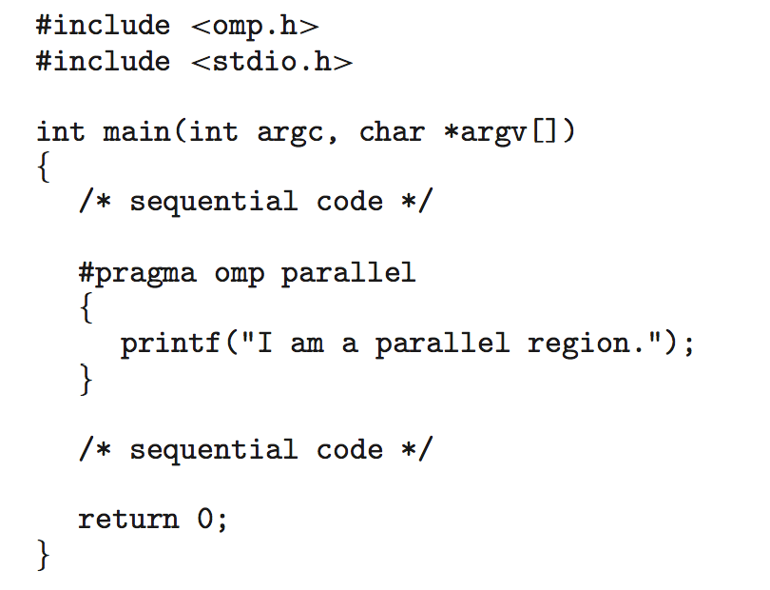
OpenMP
Set of compiler directives and an API for C, C++, FORTRAN
Provides support for parallel programming in shared-memory environments
Identifies parallel regions – blocks of code that can run in parallel
#pragma omp parallel
Create as many threads as there are cores
#pragma omp parallel for for(i=0;i<N;i++) {
c[i] = a[i] + b[i];
}
Run for loop in parallel

Slide 29
Threading Issues
Semantics of fork() and exec() system calls
Signal handling
Synchronous and asynchronous
Thread cancellation of target thread
Asynchronous or deferred
Thread-local storage
Scheduler Activations

Slide 30
Semantics of fork() and exec()
Does fork()duplicate only the calling thread or all threads?
Some UNIXes have two versions of fork
exec() usually works as normal – replace the running process including all threads

Slide 31
Signal Handling
Signals are used in UNIX systems to notify a process that a particular event has occurred.
A signal handler is used to process signals
Signal is generated by particular event
Signal is delivered to a process
Signal is handled by one of two signal handlers:
default
user-defined
Every signal has default handler that kernel runs when handling signal
User-defined signal handler can override default
For single-threaded, signal delivered to process

Slide 32
Signal Handling (Cont.)
Where should a signal be delivered for multi-threaded?
Deliver the signal to the thread to which the signal applies
Deliver the signal to every thread in the process
Deliver the signal to certain threads in the process
Assign a specific thread to receive all signals for the process

Slide 33
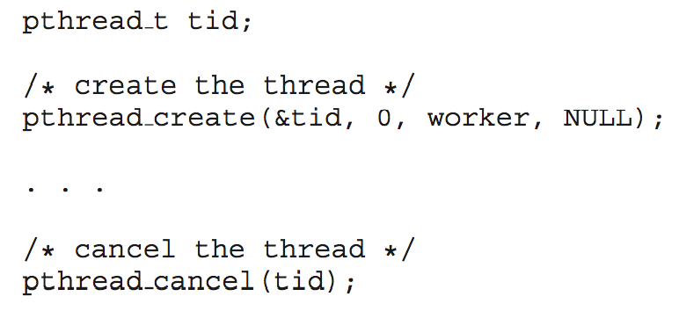
Thread Cancellation
Terminating a thread before it has finished
Thread to be canceled is target thread
Two general approaches:
Asynchronous cancellation terminates the target thread immediately
Deferred cancellation allows the target thread to periodically check if it should be cancelled
Pthread code to create and cancel a thread:

Slide 34
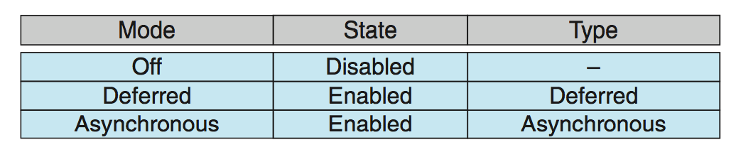
Thread Cancellation (Cont.)
Invoking thread cancellation requests cancellation, but actual cancellation depends on thread state
If thread has cancellation disabled, cancellation remains pending until thread enables it
Default type is deferred
Cancellation only occurs when thread reaches cancellation point
i.e., pthread_testcancel()
Then cleanup handler is invoked
On Linux systems, thread cancellation is handled through signals

Slide 35
Thread-Local Storage
Thread-local storage (TLS) allows each thread to have its own copy of data
Useful when you do not have control over the thread creation process (i.e., when using a thread pool)
Different from local variables
Local variables visible only during single function invocation
TLS visible across function invocations
Similar to static data
TLS is unique to each thread

Slide 36
Operating System Examples
Windows Threads
Linux Threads
Notes:
36

Slide 37
Windows Threads
Windows implements the Windows API – primary API for Win 98, Win NT, Win 2000, Win XP, and Win 7
Implements the one-to-one mapping, kernel-level
Each thread contains
A thread id
Register set representing state of processor
Separate user and kernel stacks for when thread runs in user mode or kernel mode
Private data storage area used by run-time libraries and dynamic link libraries (DLLs)
The register set, stacks, and private storage area are known as the context of the thread

Slide 38
Windows Threads (Cont.)
The primary data structures of a thread include:
ETHREAD (executive thread block) – includes pointer to process to which thread belongs and to KTHREAD, in kernel space
KTHREAD (kernel thread block) – scheduling and synchronization info, kernel-mode stack, pointer to TEB, in kernel space
TEB (thread environment block) – thread id, user-mode stack, thread-local storage, in user space

Slide 39
Windows Threads Data Structures

Slide 40
Linux Threads
Linux refers to them as tasks rather than threads
Thread creation is done through clone() system call
clone() allows a child task to share the address space of the parent task (process)
Flags control behavior
struct task_struct points to process data structures (shared or unique)

Slide 41
End of Chapter 4

Slide 42
Chapter 5: Process Synchronization

Slide 43
Chapter 5: Process Synchronization
Background
The Critical-Section Problem
Peterson’s Solution
Synchronization Hardware
Mutex Locks
Semaphores
Classic Problems of Synchronization
Monitors
Synchronization Examples
Alternative Approaches

Slide 44
Background
Processes can execute concurrently
May be interrupted at any time, partially completing execution
Concurrent access to shared data may result in data inconsistency
Maintaining data consistency requires mechanisms to ensure the orderly execution of cooperating processes
Illustration of the problem: Suppose that we wanted to provide a solution to the consumer-producer problem that fills all the buffers. We can do so by having an integer counter that keeps track of the number of full buffers. Initially, counter is set to 0. It is incremented by the producer after it produces a new buffer and is decremented by the consumer after it consumes a buffer.

Slide 45
Producer
while (true) { /* produce an item in next produced */
while (counter == BUFFER_SIZE) ;
/* do nothing */
buffer[in] = next_produced;
in = (in + 1) % BUFFER_SIZE;
counter++;
}

Slide 46
Consumer
while (true) {
while (counter == 0)
; /* do nothing */
next_consumed = buffer[out];
out = (out + 1) % BUFFER_SIZE;
counter--;
/* consume the item in next consumed */
}

Slide 47
Race Condition
counter++ could be implemented as register1 = counter register1 = register1 + 1 counter = register1
counter-- could be implemented as register2 = counter register2 = register2 - 1 counter = register2
Consider this execution interleaving with “count = 5” initially:
S0: producer execute register1 = counter {register1 = 5} S1: producer execute register1 = register1 + 1 {register1 = 6} S2: consumer execute register2 = counter {register2 = 5} S3: consumer execute register2 = register2 – 1 {register2 = 4} S4: producer execute counter = register1 {counter = 6 } S5: consumer execute counter = register2 {counter = 4}

Slide 48
Critical Section Problem
Consider system of n processes {p₀, p₁, … p_{n-1}}
Each process has critical section segment of code
Process may be changing common variables, updating table, writing file, etc
When one process in critical section, no other may be in its critical section
Critical section problem is to design protocol to solve this
Each process must ask permission to enter critical section in entry section, may follow critical section with exit section, then remainder section

Slide 49
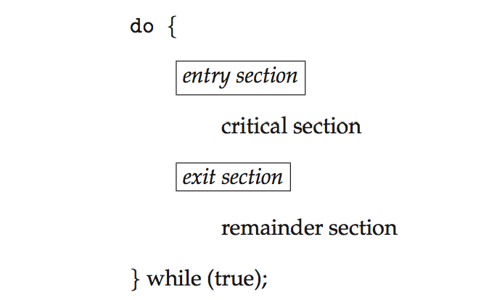
Critical Section
General structure of process P_{i}

Slide 50
Algorithm for Process P_{i}
do {
while (turn == j);
critical section
turn = j;
remainder section
} while (true);

Slide 51
Solution to Critical-Section Problem
1. Mutual Exclusion - If process P_{i} is executing in its critical section, then no other processes can be executing in their critical sections
2. Progress - If no process is executing in its critical section and there exist some processes that wish to enter their critical section, then the selection of the processes that will enter the critical section next cannot be postponed indefinitely
3. Bounded Waiting - A bound must exist on the number of times that other processes are allowed to enter their critical sections after a process has made a request to enter its critical section and before that request is granted
Assume that each process executes at a nonzero speed
No assumption concerning relative speed of the n processes

Slide 52
Critical-Section Handling in OS
Two approaches depending on if kernel is preemptive or non- preemptive
Preemptive – allows preemption of process when running in kernel mode
Non-preemptive – runs until exits kernel mode, blocks, or voluntarily yields CPU
Essentially free of race conditions in kernel mode

Slide 53
MX algorithm 1
t1 ( ) {
while (true) {
while (turn != 1); /* do nothing */
CS
turn = 2;
non-CS }
}
t2 ( ) {
while (true) {
while (turn != 2);
/* do nothing */
CS
turn = 1;
non-CS
}
}
Threads take turns entering CS.
t1 checks if it’s her turn. It it is not (turn!=1) then it waits doing nothing
if it is t1’s turn it proceeds with it’s CS and setting turn to 2 giving t2 an opportunity to enter her CS
advantages:
enforces MX
problems - unfair:
processes must alternate in CS requests, what if they are executing with different speeds? What if t2 does not want to get into CS for a while?

Slide 54
MX algorithm 2a
Before entering CS thread checks if the other is in CS
t1_in_CS,t2_in_CS indicate if corresponding thread is in CS
advantage - fair
problem - no MX!
After t1 decides that t2 is not in CS it is already in CS. Yet it takes time for t1 to set its own flag t1_in_CS to true
t1 ( ) {
while (true) {
while (t2_in_CS == true)
; /* do nothing */
t1_in_CS = true;
CS
t1_in_CS = false;
non-CS
}
}
t2 ( ) {
while (true) {
while (t1_in_CS == true)
; /* do nothing */
t2_in_CS = true;
CS
t2_in_CS = false;
non-CS
}
}

Slide 55
MX algorithm 2b
t1 ( ) {
while (true) {
t1_in_CS = true;
while (t2_in_CS == true); /* do nothing */
CS
t1_in_CS = false;
non-CS
}
}
t2 ( ) {
while (true) {
t2_in_CS = true;
while (t1_in_CS == true); /* do nothing */
CS
t2_in_CS = false;
non-CS
}
}
Let’s move the setting of the t1_in_CS flag outside of the neighbor’s flag checking
advantage - MX
problem - not fair!
Both threads cannot get to CS if they set their flags at the same time!
This condition is called deadlock and we say that threads may starve

Slide 56
Peterson’s Solution
Good algorithmic description of solving the problem
Two process solution
Assume that the load and store machine-language instructions are atomic; that is, cannot be interrupted
The two processes share two variables:
int turn;
Boolean flag[2]
The variable turn indicates whose turn it is to enter the critical section
The flag array is used to indicate if a process is ready to enter the critical section. flag[i] = true implies that process P_{i} is ready!

Slide 57
Algorithm for Process P_{i}
do {
flag[i] = true;
turn = j;
while (flag[j] && turn = = j);
critical section
flag[i] = false;
remainder section
} while (true);

Slide 58
Peterson’s Solution (Cont.)
Provable that the three CS requirement are met:
1. Mutual exclusion is preserved
P_{i} enters CS only if:
either flag[j] = false or turn = i
2. Progress requirement is satisfied
3. Bounded-waiting requirement is met

Slide 59
Synchronization Hardware
Many systems provide hardware support for implementing the critical section code.
All solutions below based on idea of locking
Protecting critical regions via locks
Uniprocessors – could disable interrupts
Currently running code would execute without preemption
Generally too inefficient on multiprocessor systems
Operating systems using this not broadly scalable
Modern machines provide special atomic hardware instructions
Atomic = non-interruptible
Either test memory word and set value
Or swap contents of two memory words

Slide 60
Solution to Critical-section Problem Using Locks
do {
acquire lock
critical section
release lock
remainder section
} while (TRUE);

Slide 61
test_and_set Instruction
Definition:
boolean test_and_set (boolean *target)
{
boolean rv = *target;
*target = TRUE;
return rv:
}
Executed atomically
Returns the original value of passed parameter
Set the new value of passed parameter to “TRUE”.

Slide 62
Solution using test_and_set()
Shared Boolean variable lock, initialized to FALSE
Solution:
do { while (test_and_set(&lock))
; /* do nothing */
/* critical section */
lock = false;
/* remainder section */
} while (true);

Slide 63
compare_and_swap Instruction
Definition:
int compare _and_swap(int *value, int expected, int new_value) {
int temp = *value;
if (*value == expected)
*value = new_value;
return temp;
}
Executed atomically
Returns the original value of passed parameter “value”
Set the variable “value” the value of the passed parameter “new_value” but only if “value” ==“expected”. That is, the swap takes place only under this condition.

Slide 64
Solution using compare_and_swap
Shared integer “lock” initialized to 0;
Solution:
do { while (compare_and_swap(&lock, 0, 1) != 0)
; /* do nothing */
/* critical section */
lock = 0;
/* remainder section */
} while (true);

Slide 65
Bounded-waiting Mutual Exclusion with test_and_set
do { waiting[i] = true; key = true; while (waiting[i] && key)
key = test_and_set(&lock);
waiting[i] = false;
/* critical section */
j = (i + 1) % n;
while ((j != i) && !waiting[j])
j = (j + 1) % n;
if (j == i)
lock = false;
else
waiting[j] = false;
/* remainder section */
} while (true);

Slide 66
Mutex Locks
Previous solutions are complicated and generally inaccessible to application programmers
OS designers build software tools to solve critical section problem
Simplest is mutex lock
Protect a critical section by first acquire() a lock then release() the lock
Boolean variable indicating if lock is available or not
Calls to acquire() and release() must be atomic
Usually implemented via hardware atomic instructions
But this solution requires busy waiting
This lock therefore called a spinlock

Slide 67
acquire() and release()
acquire() { while (!available)
; /* busy wait */
available = false;;
}
release() {
available = true;
}
do {
acquire lock
critical section
release lock
remainder section
} while (true);

Slide 68
Semaphore
Synchronization tool that provides more sophisticated ways (than Mutex locks) for process to synchronize their activities.
Semaphore S – integer variable
Can only be accessed via two indivisible (atomic) operations
wait() and signal()
Originally called P() and V()
Definition of the wait() operation
wait(S) {
while (S <= 0)
; // busy wait
S--;
}
Definition of the signal() operation
signal(S) {
S++;
}

Slide 69
Semaphore Usage
Counting semaphore – integer value can range over an unrestricted domain
Binary semaphore – integer value can range only between 0 and 1
Same as a mutex lock
Can solve various synchronization problems
Consider P₁ and P₂ that require S₁ to happen before S₂
Create a semaphore “synch” initialized to 0
P1:
S₁;
signal(synch);
P2:
wait(synch);
S₂;
Can implement a counting semaphore S as a binary semaphore

Slide 70
Semaphore Implementation
Must guarantee that no two processes can execute the wait() and signal() on the same semaphore at the same time
Thus, the implementation becomes the critical section problem where the wait and signal code are placed in the critical section
Could now have busy waiting in critical section implementation
But implementation code is short
Little busy waiting if critical section rarely occupied
Note that applications may spend lots of time in critical sections and therefore this is not a good solution

Slide 71
Semaphore Implementation with no Busy waiting
With each semaphore there is an associated waiting queue
Each entry in a waiting queue has two data items:
value (of type integer)
pointer to next record in the list
Two operations:
block – place the process invoking the operation on the appropriate waiting queue
wakeup – remove one of processes in the waiting queue and place it in the ready queue
typedef struct{
int value;
struct process *list;
} semaphore;

Slide 72
Implementation with no Busy waiting (Cont.)
wait(semaphore *S) {
S->value--;
if (S->value < 0) { add this process to S->list;
block();
}
}
signal(semaphore *S) {
S->value++;
if (S->value <= 0) { remove a process P from S->list;
wakeup(P);
}
}

Slide 73
Deadlock and Starvation
Deadlock – two or more processes are waiting indefinitely for an event that can be caused by only one of the waiting processes
Let S and Q be two semaphores initialized to 1
P₀ P₁
wait(S); wait(Q);
wait(Q); wait(S);
... ...
signal(S); signal(Q);
signal(Q); signal(S);
Starvation – indefinite blocking
A process may never be removed from the semaphore queue in which it is suspended
Priority Inversion – Scheduling problem when lower-priority process holds a lock needed by higher-priority process
Solved via priority-inheritance protocol

Slide 74
Classical Problems of Synchronization
Classical problems used to test newly-proposed synchronization schemes
Bounded-Buffer Problem
Readers and Writers Problem
Dining-Philosophers Problem

Slide 75
Bounded-Buffer Problem
n buffers, each can hold one item
Semaphore mutex initialized to the value 1
Semaphore full initialized to the value 0
Semaphore empty initialized to the value n

Slide 76
Bounded Buffer Problem (Cont.)
The structure of the producer process
do {
... /* produce an item in next_produced */
...
wait(empty);
wait(mutex);
... /* add next produced to the buffer */
...
signal(mutex);
signal(full);
} while (true);

Slide 77
Bounded Buffer Problem (Cont.)
The structure of the consumer process
Do {
wait(full);
wait(mutex);
... /* remove an item from buffer to next_consumed */
...
signal(mutex);
signal(empty);
... /* consume the item in next consumed */
... } while (true);

Slide 78
Readers-Writers Problem
A data set is shared among a number of concurrent processes
Readers – only read the data set; they do not perform any updates
Writers – can both read and write
Problem – allow multiple readers to read at the same time
Only one single writer can access the shared data at the same time
Several variations of how readers and writers are considered – all involve some form of priorities
Shared Data
Data set
Semaphore rw_mutex initialized to 1
Semaphore mutex initialized to 1
Integer read_count initialized to 0

Slide 79
Readers-Writers Problem (Cont.)
The structure of a writer process
do { wait(rw_mutex);
... /* writing is performed */
...
signal(rw_mutex);
} while (true);

Slide 80
Readers-Writers Problem (Cont.)
The structure of a reader process
do { wait(mutex); read_count++; if (read_count == 1)
wait(rw_mutex);
signal(mutex);
... /* reading is performed */
...
wait(mutex); read count--; if (read_count == 0)
signal(rw_mutex);
signal(mutex);
} while (true);

Slide 81
Readers-Writers Problem Variations
First variation – no reader kept waiting unless writer has permission to use shared object
Second variation – once writer is ready, it performs the write ASAP
Both may have starvation leading to even more variations
Problem is solved on some systems by kernel providing reader-writer locks

Slide 82

Dining-Philosophers Problem
Philosophers spend their lives alternating thinking and eating
Don’t interact with their neighbors, occasionally try to pick up 2 chopsticks (one at a time) to eat from bowl
Need both to eat, then release both when done
In the case of 5 philosophers
Shared data
Bowl of rice (data set)
Semaphore chopstick [5] initialized to 1

Slide 83
Dining-Philosophers Problem Algorithm
The structure of Philosopher i:
do {
wait (chopstick[i] );
wait (chopStick[ (i + 1) % 5] );
// eat
signal (chopstick[i] );
signal (chopstick[ (i + 1) % 5] );
// think
} while (TRUE);
What is the problem with this algorithm?

Slide 84
Dining-Philosophers Problem Algorithm (Cont.)
Deadlock handling
Allow at most 4 philosophers to be sitting simultaneously at the table.
Allow a philosopher to pick up the forks only if both are available (picking must be done in a critical section.
Use an asymmetric solution -- an odd-numbered philosopher picks up first the left chopstick and then the right chopstick. Even-numbered philosopher picks up first the right chopstick and then the left chopstick.

Slide 85
Problems with Semaphores
Incorrect use of semaphore operations:
signal (mutex) …. wait (mutex)
wait (mutex) … wait (mutex)
Omitting of wait (mutex) or signal (mutex) (or both)
Deadlock and starvation are possible.

Slide 86
Monitors
A high-level abstraction that provides a convenient and effective mechanism for process synchronization
Abstract data type, internal variables only accessible by code within the procedure
Only one process may be active within the monitor at a time
But not powerful enough to model some synchronization schemes
monitor monitor-name
{
// shared variable declarations
procedure P1 (…) { …. }
procedure Pn (…) {……}
Initialization code (…) { … }
}
}

Slide 87
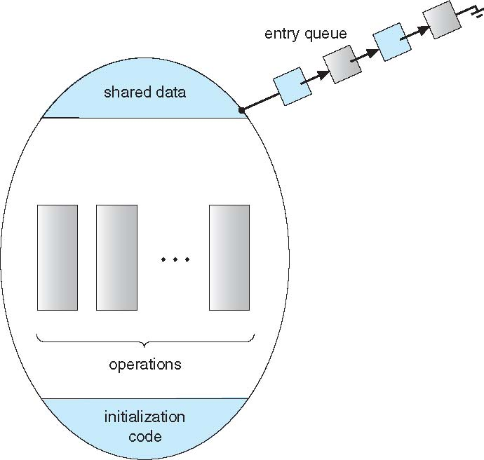
Schematic view of a Monitor

Slide 88
Condition Variables
condition x, y;
Two operations are allowed on a condition variable:
x.wait() – a process that invokes the operation is suspended until x.signal()
x.signal() – resumes one of processes (if any) that invoked x.wait()
If no x.wait() on the variable, then it has no effect on the variable

Slide 89
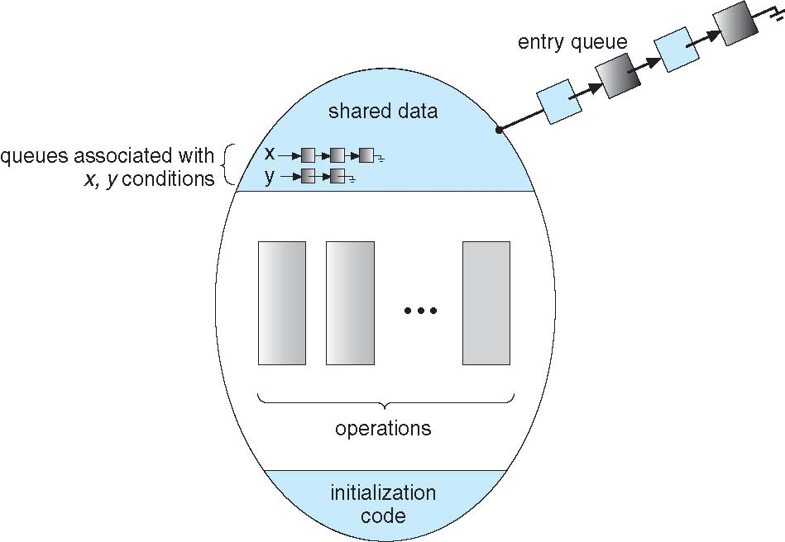
Monitor with Condition Variables

Slide 90
Condition Variables Choices
If process P invokes x.signal(), and process Q is suspended in x.wait(), what should happen next?
Both Q and P cannot execute in paralel. If Q is resumed, then P must wait
Options include
Signal and wait – P waits until Q either leaves the monitor or it waits for another condition
Signal and continue – Q waits until P either leaves the monitor or it waits for another condition
Both have pros and cons – language implementer can decide
Monitors implemented in Concurrent Pascal compromise
P executing signal immediately leaves the monitor, Q is resumed
Implemented in other languages including Mesa, C#, Java

Slide 91
Monitor Solution to Dining Philosophers
monitor DiningPhilosophers
{
enum { THINKING; HUNGRY, EATING) state [5] ;
condition self [5];
void pickup (int i) {
state[i] = HUNGRY;
test(i);
if (state[i] != EATING) self[i].wait;
}
void putdown (int i) {
state[i] = THINKING;
// test left and right neighbors
test((i + 4) % 5);
test((i + 1) % 5);
}

Slide 92
Solution to Dining Philosophers (Cont.)
void test (int i) {
if ((state[(i + 4) % 5] != EATING) &&
(state[i] == HUNGRY) &&
(state[(i + 1) % 5] != EATING) ) {
state[i] = EATING ;
self[i].signal () ;
}
}
initialization_code() {
for (int i = 0; i < 5; i++)
state[i] = THINKING;
}
}

Slide 93
Solution to Dining Philosophers (Cont.)
Each philosopher i invokes the operations pickup() and putdown() in the following sequence:
DiningPhilosophers.pickup(i);
EAT
DiningPhilosophers.putdown(i);
No deadlock, but starvation is possible

Slide 94
Monitor Implementation Using Semaphores
Variables
semaphore mutex; // (initially = 1)
semaphore next; // (initially = 0)
int next_count = 0;
Each procedure F will be replaced by
wait(mutex);
…
body of F;
…
if (next_count > 0)
signal(next)
else
signal(mutex);
Mutual exclusion within a monitor is ensured

Slide 95
Monitor Implementation – Condition Variables
For each condition variable x, we have:
semaphore x_sem; // (initially = 0)
int x_count = 0;
The operation x.wait can be implemented as:
x_count++;
if (next_count > 0)
signal(next);
else
signal(mutex);
wait(x_sem);
x_count--;

Slide 96
Monitor Implementation (Cont.)
The operation x.signal can be implemented as:
if (x_count > 0) {
next_count++;
signal(x_sem);
wait(next);
next_count--;
}

Slide 97
Resuming Processes within a Monitor
If several processes queued on condition x, and x.signal() executed, which should be resumed?
FCFS frequently not adequate
conditional-wait construct of the form x.wait(c)
Where c is priority number
Process with lowest number (highest priority) is scheduled next

Slide 98
Single Resource allocation
Allocate a single resource among competing processes using priority numbers that specify the maximum time a process plans to use the resource
R.acquire(t);
...
access the resurce;
...
R.release;
Where R is an instance of type ResourceAllocator

Slide 99
A Monitor to Allocate Single Resource
monitor ResourceAllocator
{
boolean busy;
condition x;
void acquire(int time) {
if (busy)
x.wait(time);
busy = TRUE;
}
void release() {
busy = FALSE;
x.signal();
}
initialization code() {
busy = FALSE;
}
}

Slide 100
Synchronization Examples
Solaris
Windows
Linux
Pthreads

Slide 101
Solaris Synchronization
Implements a variety of locks to support multitasking, multithreading (including real-time threads), and multiprocessing
Uses adaptive mutexes for efficiency when protecting data from short code segments
Starts as a standard semaphore spin-lock
If lock held, and by a thread running on another CPU, spins
If lock held by non-run-state thread, block and sleep waiting for signal of lock being released
Uses condition variables
Uses readers-writers locks when longer sections of code need access to data
Uses turnstiles to order the list of threads waiting to acquire either an adaptive mutex or reader-writer lock
Turnstiles are per-lock-holding-thread, not per-object
Priority-inheritance per-turnstile gives the running thread the highest of the priorities of the threads in its turnstile

Slide 102
Windows Synchronization
Uses interrupt masks to protect access to global resources on uniprocessor systems
Uses spinlocks on multiprocessor systems
Spinlocking-thread will never be preempted
Also provides dispatcher objects user-land which may act mutexes, semaphores, events, and timers
Events
An event acts much like a condition variable
Timers notify one or more thread when time expired
Dispatcher objects either signaled-state (object available) or non-signaled state (thread will block)

Slide 103
Linux Synchronization
Linux:
Prior to kernel Version 2.6, disables interrupts to implement short critical sections
Version 2.6 and later, fully preemptive
Linux provides:
Semaphores
atomic integers
spinlocks
reader-writer versions of both
On single-cpu system, spinlocks replaced by enabling and disabling kernel preemption

Slide 104
Pthreads Synchronization
Pthreads API is OS-independent
It provides:
mutex locks
condition variable
Non-portable extensions include:
read-write locks
spinlocks

Slide 105
Alternative Approaches
Transactional Memory
OpenMP
Functional Programming Languages

Slide 106
Transactional Memory
A memory transaction is a sequence of read-write operations to memory that are performed atomically.
void update()
{
/* read/write memory */
}

Slide 107
OpenMP
OpenMP is a set of compiler directives and API that support parallel progamming.
void update(int value)
{
#pragma omp critical
{
count += value
}
}
The code contained within the #pragma omp critical directive is treated as a critical section and performed atomically.

Slide 108
Functional Programming Languages
Functional programming languages offer a different paradigm than procedural languages in that they do not maintain state.
Variables are treated as immutable and cannot change state once they have been assigned a value.
There is increasing interest in functional languages such as Erlang and Scala for their approach in handling data races.

Slide 109
End of Chapter 5

Slide 110
Chapter 6: CPU Scheduling

Slide 111
Chapter 6: CPU Scheduling
Basic Concepts
Scheduling Criteria
Scheduling Algorithms
Thread Scheduling
Multiple-Processor Scheduling
Real-Time CPU Scheduling
Operating Systems Examples
Algorithm Evaluation

Slide 112
Basic Concepts
Maximum CPU utilization obtained with multiprogramming
CPU–I/O Burst Cycle – Process execution consists of a cycle of CPU execution and I/O wait
CPU burst followed by I/O burst
CPU burst distribution is of main concern

Slide 113
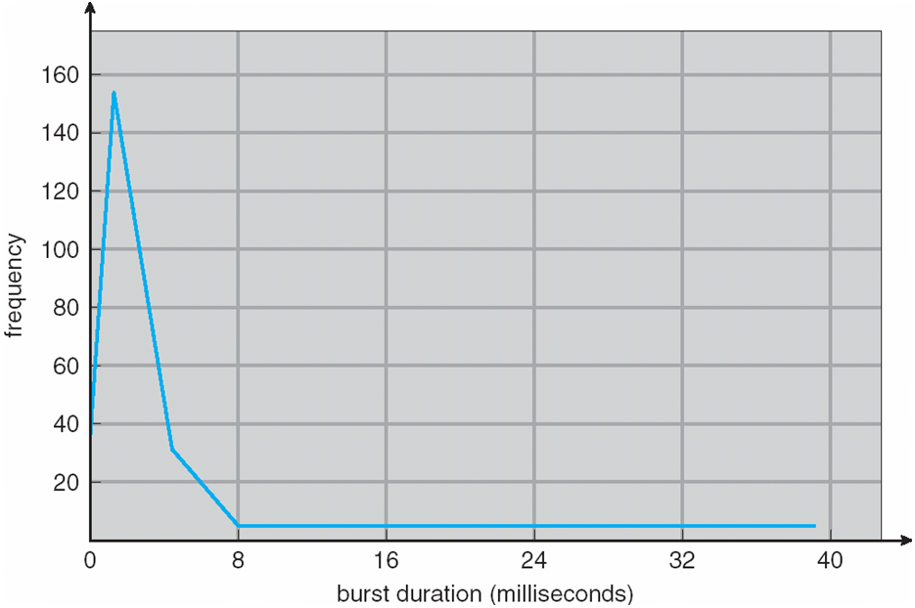
Histogram of CPU-burst Times

Slide 114
CPU Scheduler
Short-term scheduler selects from among the processes in ready queue, and allocates the CPU to one of them
Queue may be ordered in various ways
CPU scheduling decisions may take place when a process:
1. Switches from running to waiting state
2. Switches from running to ready state
3. Switches from waiting to ready
Terminates
Scheduling under 1 and 4 is nonpreemptive
All other scheduling is preemptive
Consider access to shared data
Consider preemption while in kernel mode
Consider interrupts occurring during crucial OS activities

Slide 115
Dispatcher
Dispatcher module gives control of the CPU to the process selected by the short-term scheduler; this involves:
switching context
switching to user mode
jumping to the proper location in the user program to restart that program
Dispatch latency – time it takes for the dispatcher to stop one process and start another running

Slide 116
Scheduling Criteria
CPU utilization – keep the CPU as busy as possible
Throughput – # of processes that complete their execution per time unit
Turnaround time – amount of time to execute a particular process
Waiting time – amount of time a process has been waiting in the ready queue
Response time – amount of time it takes from when a request was submitted until the first response is produced, not output (for time-sharing environment)

Slide 117
Scheduling Algorithm Optimization Criteria
Max CPU utilization
Max throughput
Min turnaround time
Min waiting time
Min response time

Slide 118
First- Come, First-Served (FCFS) Scheduling
Process Burst Time
P₁ 24
P₂ 3
P₃ 3
Suppose that the processes arrive in the order: P₁ , P₂ , P₃ The Gantt Chart for the schedule is:
Waiting time for P₁ = 0; P₂ = 24; P₃ = 27
Average waiting time: (0 + 24 + 27)/3 = 17

Slide 119
FCFS Scheduling (Cont.)
Suppose that the processes arrive in the order:
P₂ , P₃ , P₁
The Gantt chart for the schedule is:
Waiting time for P₁ = 6; P₂ = 0; P₃ = 3
Average waiting time: (6 + 0 + 3)/3 = 3
Much better than previous case
Convoy effect - short process behind long process
Consider one CPU-bound and many I/O-bound processes

Slide 120
Shortest-Job-First (SJF) Scheduling
Associate with each process the length of its next CPU burst
Use these lengths to schedule the process with the shortest time
SJF is optimal – gives minimum average waiting time for a given set of processes
The difficulty is knowing the length of the next CPU request
Could ask the user

Slide 121
Example of SJF
ProcessArriva l Time Burst Time
P₁ 0.0 6
P₂ 2.0 8
P₃ 4.0 7
P₄ 5.0 3
SJF scheduling chart
Average waiting time = (3 + 16 + 9 + 0) / 4 = 7

Slide 122
Determining Length of Next CPU Burst
Can only estimate the length – should be similar to the previous one
Then pick process with shortest predicted next CPU burst
Can be done by using the length of previous CPU bursts, using exponential averaging
Commonly, α set to ½
Preemptive version called shortest-remaining-time-first

Slide 123
Prediction of the Length of the Next CPU Burst

Slide 124
Examples of Exponential Averaging
α =0
τ_{n+1} = τ_{n}
Recent history does not count
α =1
τ_{n+1} = α t_{n}
Only the actual last CPU burst counts
If we expand the formula, we get:
τ_{n+1} = α t_{n}+(1 - α)α t_{n} ₋₁ + …
+(1 - α )^{j} α t_{n} _{-j} + …
+(1 - α )^{n +1} τ₀
Since both α and (1 - α) are less than or equal to 1, each successive term has less weight than its predecessor

Slide 125
Example of Shortest-remaining-time-first
Now we add the concepts of varying arrival times and preemption to the analysis
ProcessA arri Arrival TimeT Burst Time
P₁ 0 8
P₂ 1 4
P₃ 2 9
P₄ 3 5
Preemptive SJF Gantt Chart
Average waiting time = [(10-1)+(1-1)+(17-2)+5-3)]/4 = 26/4 = 6.5 msec

Slide 126
Priority Scheduling
A priority number (integer) is associated with each process
The CPU is allocated to the process with the highest priority (smallest integer ≡ highest priority)
Preemptive
Nonpreemptive
SJF is priority scheduling where priority is the inverse of predicted next CPU burst time
Problem ≡ Starvation – low priority processes may never execute
Solution ≡ Aging – as time progresses increase the priority of the process

Slide 127
Example of Priority Scheduling
ProcessA arri Burst TimeT Priority
P₁ 10 3
P₂ 1 1
P₃ 2 4
P₄ 1 5
P₅ 5 2
Priority scheduling Gantt Chart
Average waiting time = 8.2 msec
2
5

Slide 128
Round Robin (RR)
Each process gets a small unit of CPU time (time quantum q), usually 10-100 milliseconds. After this time has elapsed, the process is preempted and added to the end of the ready queue.
If there are n processes in the ready queue and the time quantum is q, then each process gets 1/n of the CPU time in chunks of at most q time units at once. No process waits more than (n-1)q time units.
Timer interrupts every quantum to schedule next process
Performance
q large ⇒ FIFO
q small ⇒ q must be large with respect to context switch, otherwise overhead is too high

Slide 129
Example of RR with Time Quantum = 4
Process Burst Time
P₁ 24
P₂ 3
P₃ 3
The Gantt chart is:
Typically, higher average turnaround than SJF, but better response
q should be large compared to context switch time
q usually 10ms to 100ms, context switch < 10 usec

Slide 130
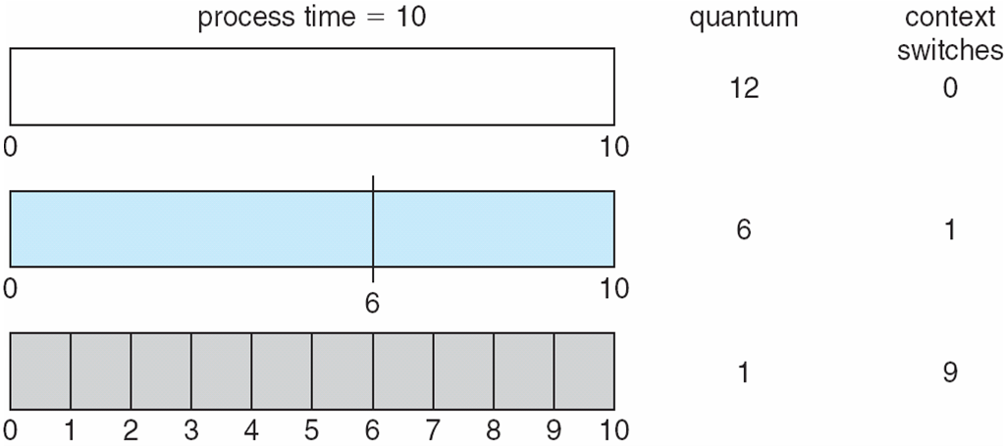
Time Quantum and Context Switch Time

Slide 131
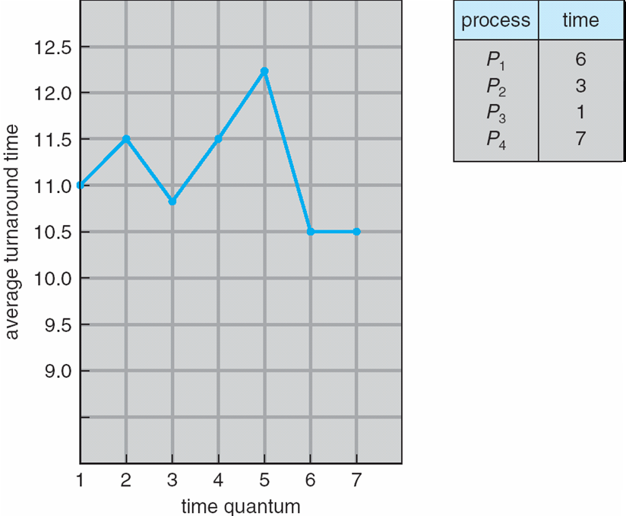
Turnaround Time Varies With The Time Quantum
80% of CPU bursts should be shorter than q

Slide 132
Multilevel Queue
Ready queue is partitioned into separate queues, eg:
foreground (interactive)
background (batch)
Process permanently in a given queue
Each queue has its own scheduling algorithm:
foreground – RR
background – FCFS
Scheduling must be done between the queues:
Fixed priority scheduling; (i.e., serve all from foreground then from background). Possibility of starvation.
Time slice – each queue gets a certain amount of CPU time which it can schedule amongst its processes; i.e., 80% to foreground in RR
20% to background in FCFS

Slide 133
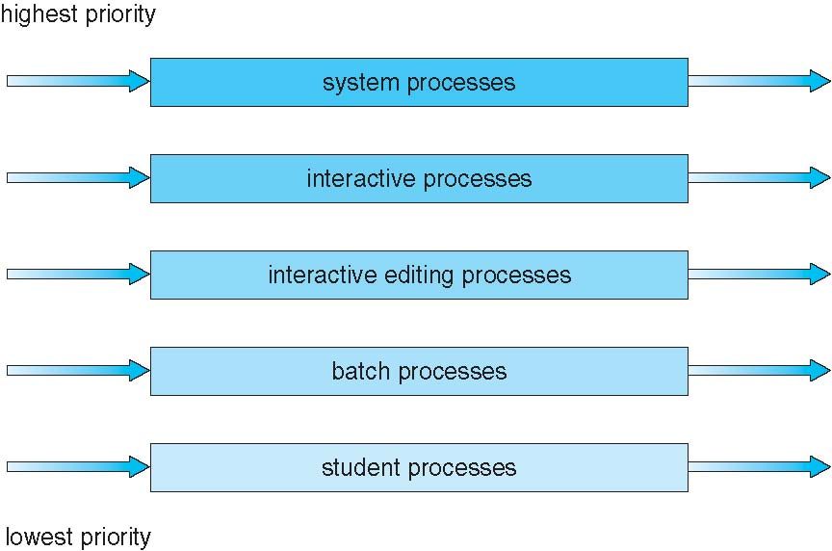
Multilevel Queue Scheduling

Slide 134
Multilevel Feedback Queue
A process can move between the various queues; aging can be implemented this way
Multilevel-feedback-queue scheduler defined by the following parameters:
number of queues
scheduling algorithms for each queue
method used to determine when to upgrade a process
method used to determine when to demote a process
method used to determine which queue a process will enter when that process needs service

Slide 135
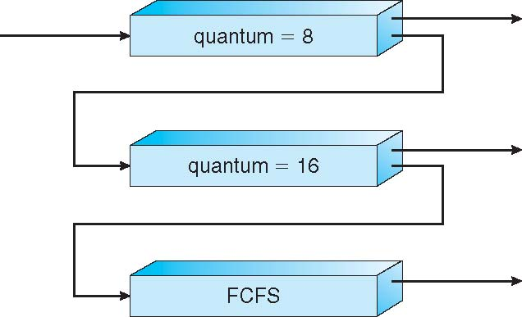
Example of Multilevel Feedback Queue
Three queues:
Q₀ – RR with time quantum 8 milliseconds
Q₁ – RR time quantum 16 milliseconds
Q₂ – FCFS
Scheduling
A new job enters queue Q₀ which is served FCFS
When it gains CPU, job receives 8 milliseconds
If it does not finish in 8 milliseconds, job is moved to queue Q₁
At Q₁ job is again served FCFS and receives 16 additional milliseconds
If it still does not complete, it is preempted and moved to queue Q₂

Slide 136
Thread Scheduling
Distinction between user-level and kernel-level threads
When threads supported, threads scheduled, not processes
Many-to-one and many-to-many models, thread library schedules user-level threads to run on LWP
Known as process-contention scope (PCS) since scheduling competition is within the process
Typically done via priority set by programmer
Kernel thread scheduled onto available CPU is system-contention scope (SCS) – competition among all threads in system

Slide 137
Pthread Scheduling
API allows specifying either PCS or SCS during thread creation
PTHREAD_SCOPE_PROCESS schedules threads using PCS scheduling
PTHREAD_SCOPE_SYSTEM schedules threads using SCS scheduling
Can be limited by OS – Linux and Mac OS X only allow PTHREAD_SCOPE_SYSTEM

Slide 138
Pthread Scheduling API
#include <pthread.h>
#include <stdio.h>
#define NUM_THREADS 5
int main(int argc, char *argv[]) {
int i, scope; pthread_t tid[NUM THREADS];
pthread_attr_t attr;
/* get the default attributes */
pthread_attr_init(&attr);
/* first inquire on the current scope */ if (pthread_attr_getscope(&attr, &scope) != 0)
fprintf(stderr, "Unable to get scheduling scope\n");
else {
if (scope == PTHREAD_SCOPE_PROCESS)
printf("PTHREAD_SCOPE_PROCESS");
else if (scope == PTHREAD_SCOPE_SYSTEM)
printf("PTHREAD_SCOPE_SYSTEM");
else fprintf(stderr, "Illegal scope value.\n");
}

Slide 139
Pthread Scheduling API
/* set the scheduling algorithm to PCS or SCS */
pthread_attr_setscope(&attr, PTHREAD_SCOPE_SYSTEM);
/* create the threads */ for (i = 0; i < NUM_THREADS; i++)
pthread_create(&tid[i],&attr,runner,NULL);
/* now join on each thread */ for (i = 0; i < NUM_THREADS; i++)
pthread_join(tid[i], NULL);
}
/* Each thread will begin control in this function */
void *runner(void *param) {
/* do some work ... */
pthread_exit(0);
}

Slide 140
Multiple-Processor Scheduling
CPU scheduling more complex when multiple CPUs are available
Homogeneous processors within a multiprocessor
Asymmetric multiprocessing – only one processor accesses the system data structures, alleviating the need for data sharing
Symmetric multiprocessing (SMP) – each processor is self-scheduling, all processes in common ready queue, or each has its own private queue of ready processes
Currently, most common
Processor affinity – process has affinity for processor on which it is currently running
soft affinity
hard affinity
Variations including processor sets

Slide 141
NUMA and CPU Scheduling
Note that memory-placement algorithms can also consider affinity

Slide 142
Multiple-Processor Scheduling – Load Balancing
If SMP, need to keep all CPUs loaded for efficiency
Load balancing attempts to keep workload evenly distributed
Push migration – periodic task checks load on each processor, and if found pushes task from overloaded CPU to other CPUs
Pull migration – idle processors pulls waiting task from busy processor

Slide 143
Multicore Processors
Recent trend to place multiple processor cores on same physical chip
Faster and consumes less power
Multiple threads per core also growing
Takes advantage of memory stall to make progress on another thread while memory retrieve happens

Slide 144
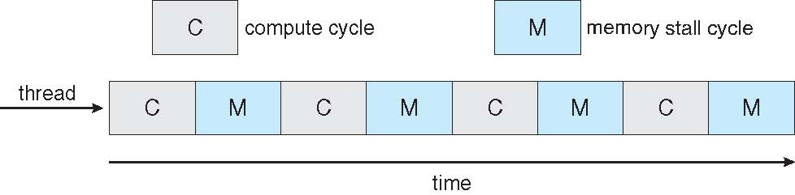
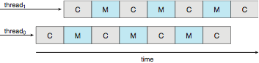
Multithreaded Multicore System

Slide 145
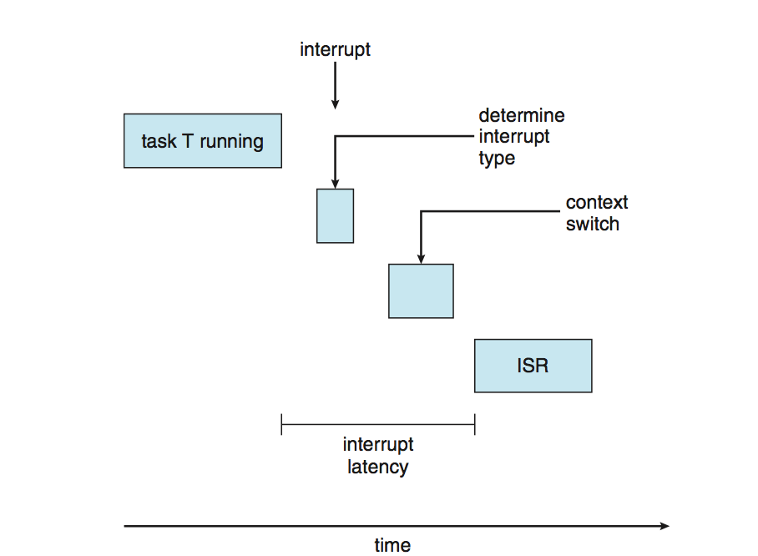
Real-Time CPU Scheduling
Can present obvious challenges
Soft real-time systems – no guarantee as to when critical real-time process will be scheduled
Hard real-time systems – task must be serviced by its deadline
Two types of latencies affect performance
Interrupt latency – time from arrival of interrupt to start of routine that services interrupt
Dispatch latency – time for schedule to take current process off CPU and switch to another

Slide 146
Real-Time CPU Scheduling (Cont.)
Conflict phase of dispatch latency:
Preemption of any process running in kernel mode
Release by low-priority process of resources needed by high-priority processes

Slide 147
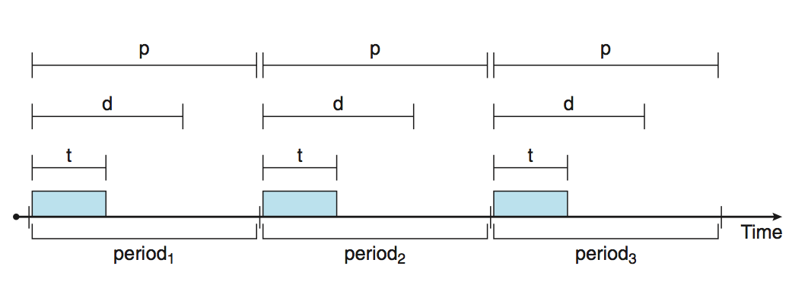
Priority-based Scheduling
For real-time scheduling, scheduler must support preemptive, priority-based scheduling
But only guarantees soft real-time
For hard real-time must also provide ability to meet deadlines
Processes have new characteristics: periodic ones require CPU at constant intervals
Has processing time t, deadline d, period p
0 ≤ t ≤ d ≤ p
Rate of periodic task is 1/p

Slide 148
Virtualization and Scheduling
Virtualization software schedules multiple guests onto CPU(s)
Each guest doing its own scheduling
Not knowing it doesn’t own the CPUs
Can result in poor response time
Can effect time-of-day clocks in guests
Can undo good scheduling algorithm efforts of guests

Slide 149
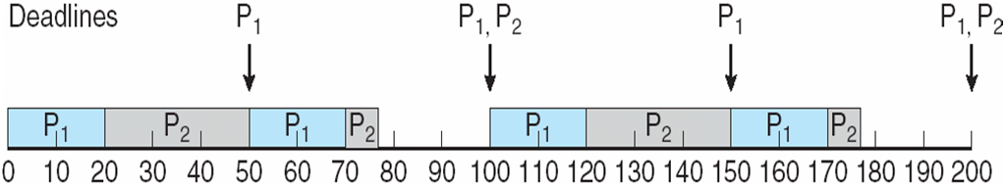
Rate Montonic Scheduling
A priority is assigned based on the inverse of its period
Shorter periods = higher priority;
Longer periods = lower priority
P₁ is assigned a higher priority than P₂.

Slide 150
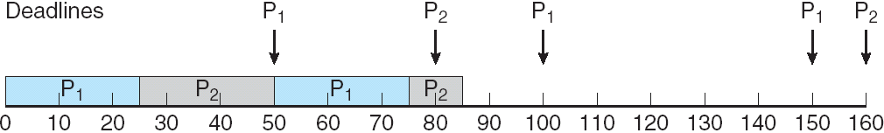
Missed Deadlines with Rate Monotonic Scheduling

Slide 151
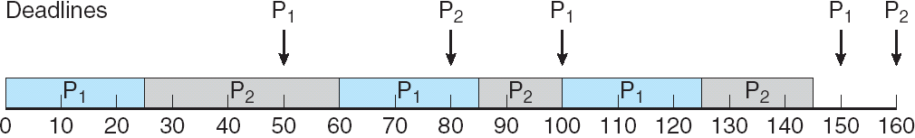
Earliest Deadline First Scheduling (EDF)
Priorities are assigned according to deadlines: the earlier the deadline, the higher the priority;
the later the deadline, the lower the priority

Slide 152
Proportional Share Scheduling
T shares are allocated among all processes in the system
An application receives N shares where N < T
This ensures each application will receive N / T of the total processor time

Slide 153
POSIX Real-Time Scheduling
The POSIX.1b standard
API provides functions for managing real-time threads
Defines two scheduling classes for real-time threads:
SCHED_FIFO - threads are scheduled using a FCFS strategy with a FIFO queue. There is no time-slicing for threads of equal priority
SCHED_RR - similar to SCHED_FIFO except time-slicing occurs for threads of equal priority
Defines two functions for getting and setting scheduling policy:
pthread_attr_getsched_policy(pthread_attr_t *attr, int *policy)
pthread_attr_setsched_policy(pthread_attr_t *attr, int policy)

Slide 154
POSIX Real-Time Scheduling API
#include <pthread.h>
#include <stdio.h>
#define NUM_THREADS 5
int main(int argc, char *argv[])
{
int i, policy; pthread_t_tid[NUM_THREADS];
pthread_attr_t attr;
/* get the default attributes */
pthread_attr_init(&attr);
/* get the current scheduling policy */ if (pthread_attr_getschedpolicy(&attr, &policy) != 0)
fprintf(stderr, "Unable to get policy.\n");
else {
if (policy == SCHED_OTHER) printf("SCHED_OTHER\n");
else if (policy == SCHED_RR) printf("SCHED_RR\n");
else if (policy == SCHED_FIFO) printf("SCHED_FIFO\n");
}

Slide 155
POSIX Real-Time Scheduling API (Cont.)
/* set the scheduling policy - FIFO, RR, or OTHER */ if (pthread_attr_setschedpolicy(&attr, SCHED_FIFO) != 0)
fprintf(stderr, "Unable to set policy.\n");
/* create the threads */ for (i = 0; i < NUM_THREADS; i++)
pthread_create(&tid[i],&attr,runner,NULL);
/* now join on each thread */ for (i = 0; i < NUM_THREADS; i++)
pthread_join(tid[i], NULL);
}
/* Each thread will begin control in this function */
void *runner(void *param) {
/* do some work ... */
pthread_exit(0);
}

Slide 156
Operating System Examples
Linux scheduling
Windows scheduling
Solaris scheduling

Slide 157
Linux Scheduling Through Version 2.5
Prior to kernel version 2.5, ran variation of standard UNIX scheduling algorithm
Version 2.5 moved to constant order O(1) scheduling time
Preemptive, priority based
Two priority ranges: time-sharing and real-time
Real-time range from 0 to 99 and nice value from 100 to 140
Map into global priority with numerically lower values indicating higher priority
Higher priority gets larger q
Task run-able as long as time left in time slice (active)
If no time left (expired), not run-able until all other tasks use their slices
All run-able tasks tracked in per-CPU runqueue data structure
Two priority arrays (active, expired)
Tasks indexed by priority
When no more active, arrays are exchanged
Worked well, but poor response times for interactive processes

Slide 158
Linux Scheduling in Version 2.6.23 +
Completely Fair Scheduler (CFS)
Scheduling classes
Each has specific priority
Scheduler picks highest priority task in highest scheduling class
Rather than quantum based on fixed time allotments, based on proportion of CPU time
2 scheduling classes included, others can be added
default
real-time
Quantum calculated based on nice value from -20 to +19
Lower value is higher priority
Calculates target latency – interval of time during which task should run at least once
Target latency can increase if say number of active tasks increases
CFS scheduler maintains per task virtual run time in variable vruntime
Associated with decay factor based on priority of task – lower priority is higher decay rate
Normal default priority yields virtual run time = actual run time
To decide next task to run, scheduler picks task with lowest virtual run time

Slide 159
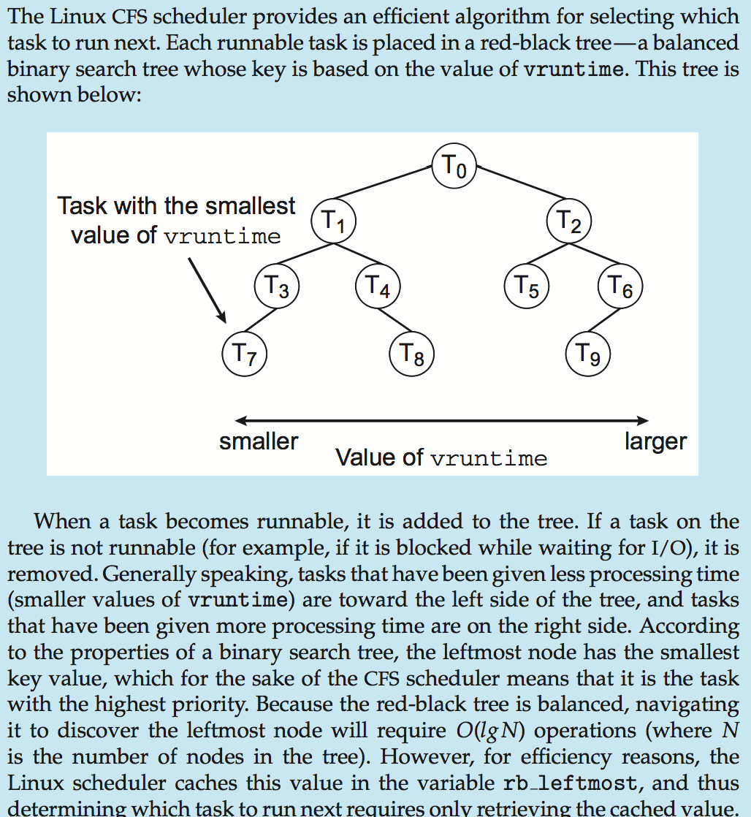
CFS Performance

Slide 160
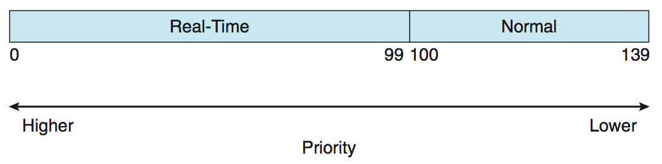
Linux Scheduling (Cont.)
Real-time scheduling according to POSIX.1b
Real-time tasks have static priorities
Real-time plus normal map into global priority scheme
Nice value of -20 maps to global priority 100
Nice value of +19 maps to priority 139

Slide 161
Windows Scheduling
Windows uses priority-based preemptive scheduling
Highest-priority thread runs next
Dispatcher is scheduler
Thread runs until (1) blocks, (2) uses time slice, (3) preempted by higher-priority thread
Real-time threads can preempt non-real-time
32-level priority scheme
Variable class is 1-15, real-time class is 16-31
Priority 0 is memory-management thread
Queue for each priority
If no run-able thread, runs idle thread

Slide 162
Windows Priority Classes
Win32 API identifies several priority classes to which a process can belong
REALTIME_PRIORITY_CLASS, HIGH_PRIORITY_CLASS, ABOVE_NORMAL_PRIORITY_CLASS,NORMAL_PRIORITY_CLASS, BELOW_NORMAL_PRIORITY_CLASS, IDLE_PRIORITY_CLASS
All are variable except REALTIME
A thread within a given priority class has a relative priority
TIME_CRITICAL, HIGHEST, ABOVE_NORMAL, NORMAL, BELOW_NORMAL, LOWEST, IDLE
Priority class and relative priority combine to give numeric priority
Base priority is NORMAL within the class
If quantum expires, priority lowered, but never below base

Slide 163
Windows Priority Classes (Cont.)
If wait occurs, priority boosted depending on what was waited for
Foreground window given 3x priority boost
Windows 7 added user-mode scheduling (UMS)
Applications create and manage threads independent of kernel
For large number of threads, much more efficient
UMS schedulers come from programming language libraries like C++ Concurrent Runtime (ConcRT) framework

Slide 164
Windows Priorities

Slide 165
Solaris
Priority-based scheduling
Six classes available
Time sharing (default) (TS)
Interactive (IA)
Real time (RT)
System (SYS)
Fair Share (FSS)
Fixed priority (FP)
Given thread can be in one class at a time
Each class has its own scheduling algorithm
Time sharing is multi-level feedback queue
Loadable table configurable by sysadmin

Slide 166
Solaris Dispatch Table

Slide 167
Solaris Scheduling

Slide 168
Solaris Scheduling (Cont.)
Scheduler converts class-specific priorities into a per-thread global priority
Thread with highest priority runs next
Runs until (1) blocks, (2) uses time slice, (3) preempted by higher-priority thread
Multiple threads at same priority selected via RR

Slide 169
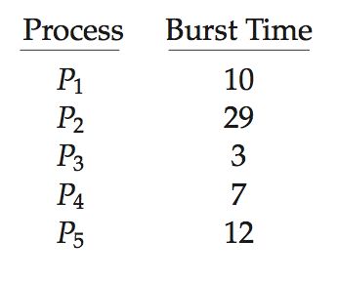
Algorithm Evaluation
How to select CPU-scheduling algorithm for an OS?
Determine criteria, then evaluate algorithms
Deterministic modeling
Type of analytic evaluation
Takes a particular predetermined workload and defines the performance of each algorithm for that workload
Consider 5 processes arriving at time 0:

Slide 170
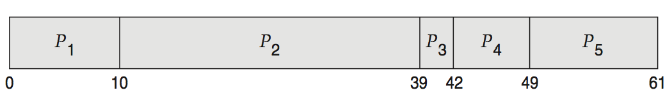
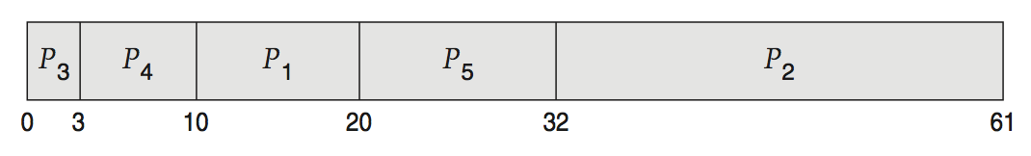
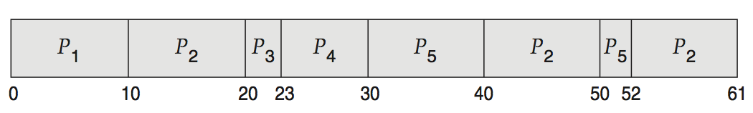
Deterministic Evaluation
For each algorithm, calculate minimum average waiting time
Simple and fast, but requires exact numbers for input, applies only to those inputs
FCS is 28ms:
Non-preemptive SFJ is 13ms:
RR is 23ms:

Slide 171
Queueing Models
Describes the arrival of processes, and CPU and I/O bursts probabilistically
Commonly exponential, and described by mean
Computes average throughput, utilization, waiting time, etc
Computer system described as network of servers, each with queue of waiting processes
Knowing arrival rates and service rates
Computes utilization, average queue length, average wait time, etc

Slide 172
Little’s Formula
n = average queue length
W = average waiting time in queue
λ = average arrival rate into queue
Little’s law – in steady state, processes leaving queue must equal processes arriving, thus: n = λ x W
Valid for any scheduling algorithm and arrival distribution
For example, if on average 7 processes arrive per second, and normally 14 processes in queue, then average wait time per process = 2 seconds

Slide 173
Simulations
Queueing models limited
Simulations more accurate
Programmed model of computer system
Clock is a variable
Gather statistics indicating algorithm performance
Data to drive simulation gathered via
Random number generator according to probabilities
Distributions defined mathematically or empirically
Trace tapes record sequences of real events in real systems

Slide 174
Evaluation of CPU Schedulers by Simulation

Slide 175
Implementation
Even simulations have limited accuracy
Just implement new scheduler and test in real systems
High cost, high risk
Environments vary
Most flexible schedulers can be modified per-site or per-system
Or APIs to modify priorities
But again environments vary

Slide 176
End of Chapter 6

Slide 177
Chapter 7: Deadlocks

Slide 178
Chapter 7: Deadlocks
System Model
Deadlock Characterization
Methods for Handling Deadlocks
Deadlock Prevention
Deadlock Avoidance
Deadlock Detection
Recovery from Deadlock

Slide 179
System Model
System consists of resources
Resource types R₁, R₂, . . ., R_{m}
CPU cycles, memory space, I/O devices
Each resource type R_{i} has W_{i} instances.
Each process utilizes a resource as follows:
request
use
release

Slide 180
Deadlock Characterization
Deadlock can arise if four conditions hold simultaneously.
Mutual exclusion: only one process at a time can use a resource
Hold and wait: a process holding at least one resource is waiting to acquire additional resources held by other processes
No preemption: a resource can be released only voluntarily by the process holding it, after that process has completed its task
Circular wait: there exists a set {P₀, P₁, …, P_{n}} of waiting processes such that P₀ is waiting for a resource that is held by P₁, P₁ is waiting for a resource that is held by P₂, …, P_{n–1} is waiting for a resource that is held by P_{n}, and P_{n} is waiting for a resource that is held by P₀.

Slide 181
Deadlock with Mutex Locks
Deadlocks can occur via system calls, locking, etc.
See example box in text page 318 for mutex deadlock

Slide 182
Resource-Allocation Graph
A set of vertices V and a set of edges E.
V is partitioned into two types:
P = {P₁, P₂, …, P_{n}}, the set consisting of all the processes in the system
R = {R₁, R₂, …, R_{m}}, the set consisting of all resource types in the system
request edge – directed edge P_{i} → R_{j}
assignment edge – directed edge R_{j} → P_{i}

Slide 183
Resource-Allocation Graph (Cont.)
Process
Resource Type with 4 instances
P_{i} requests instance of R_{j}
P_{i} is holding an instance of R_{j}
P_{i}
R_{j}
P_{i}
R_{j}

Slide 184
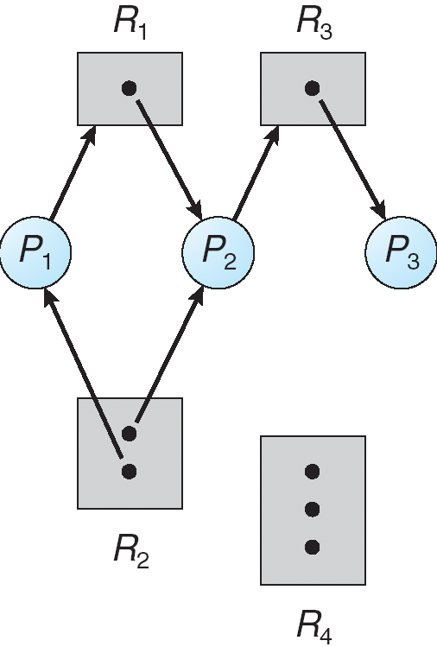
Example of a Resource Allocation Graph

Slide 185
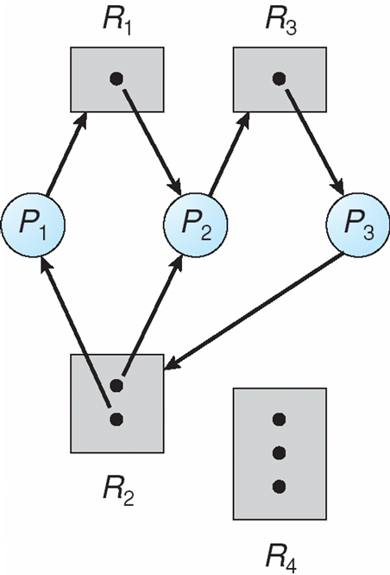
Resource Allocation Graph With A Deadlock

Slide 186
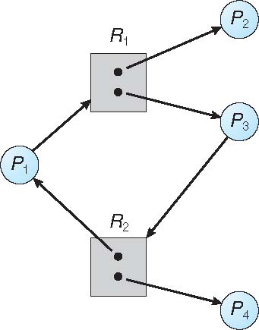
Graph With A Cycle But No Deadlock

Slide 187
Basic Facts
If graph contains no cycles ⇒ no deadlock
If graph contains a cycle ⇒
if only one instance per resource type, then deadlock
if several instances per resource type, possibility of deadlock

Slide 188
Methods for Handling Deadlocks
Ensure that the system will never enter a deadlock state:
Deadlock prevention
Deadlock avoidence
Allow the system to enter a deadlock state and then recover
Ignore the problem and pretend that deadlocks never occur in the system; used by most operating systems, including UNIX

Slide 189
Deadlock Prevention
Restrain the ways request can be made
Mutual Exclusion – not required for sharable resources (e.g., read-only files); must hold for non-sharable resources
Hold and Wait – must guarantee that whenever a process requests a resource, it does not hold any other resources
Require process to request and be allocated all its resources before it begins execution, or allow process to request resources only when the process has none allocated to it.
Low resource utilization; starvation possible

Slide 190
Deadlock Prevention (Cont.)
No Preemption –
If a process that is holding some resources requests another resource that cannot be immediately allocated to it, then all resources currently being held are released
Preempted resources are added to the list of resources for which the process is waiting
Process will be restarted only when it can regain its old resources, as well as the new ones that it is requesting
Circular Wait – impose a total ordering of all resource types, and require that each process requests resources in an increasing order of enumeration

Slide 191
Deadlock Example
/* thread one runs in this function */
void *do_work_one(void *param) {
pthread_mutex_lock(&first_mutex);
pthread_mutex_lock(&second_mutex);
/** * Do some work */ pthread_mutex_unlock(&second_mutex);
pthread_mutex_unlock(&first_mutex);
pthread_exit(0);
}
/* thread two runs in this function */
void *do_work_two(void *param) {
pthread_mutex_lock(&second_mutex);
pthread_mutex_lock(&first_mutex);
/** * Do some work */ pthread_mutex_unlock(&first_mutex);
pthread_mutex_unlock(&second_mutex);
pthread_exit(0);
}

Slide 192
Deadlock Example with Lock Ordering
void transaction(Account from, Account to, double amount)
{
mutex lock1, lock2;
lock1 = get_lock(from);
lock2 = get_lock(to);
acquire(lock1);
acquire(lock2);
withdraw(from, amount);
deposit(to, amount);
release(lock2);
release(lock1);
}
Transactions 1 and 2 execute concurrently. Transaction 1 transfers $25 from account A to account B, and Transaction 2 transfers $50 from account B to account A

Slide 193
Deadlock Avoidance
Requires that the system has some additional a priori information available
Simplest and most useful model requires that each process declare the maximum number of resources of each type that it may need
The deadlock-avoidance algorithm dynamically examines the resource-allocation state to ensure that there can never be a circular-wait condition
Resource-allocation state is defined by the number of available and allocated resources, and the maximum demands of the processes

Slide 194
Safe State
When a process requests an available resource, system must decide if immediate allocation leaves the system in a safe state
System is in safe state if there exists a sequence <P₁, P₂, …, P_{n}> of ALL the processes in the systems such that for each P_{i}, the resources that P_{i} can still request can be satisfied by currently available resources + resources held by all the P_{j}, with j < I
That is:
If P_{i} resource needs are not immediately available, then P_{i} can wait until all P_{j} have finished
When P_{j} is finished, P_{i} can obtain needed resources, execute, return allocated resources, and terminate
When P_{i} terminates, P_{i +1} can obtain its needed resources, and so on

Slide 195
Basic Facts
If a system is in safe state ⇒ no deadlocks
If a system is in unsafe state ⇒ possibility of deadlock
Avoidance ⇒ ensure that a system will never enter an unsafe state.

Slide 196
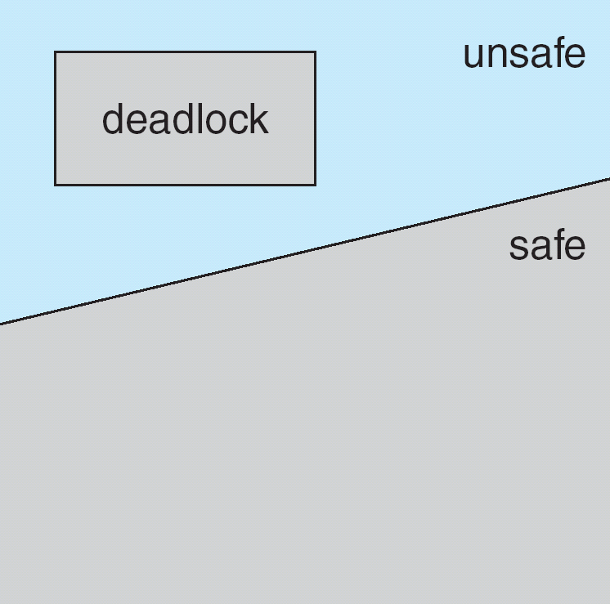
Safe, Unsafe, Deadlock State

Slide 197
Avoidance Algorithms
Single instance of a resource type
Use a resource-allocation graph
Multiple instances of a resource type
Use the banker’s algorithm

Slide 198
Resource-Allocation Graph Scheme
Claim edge P_{i} → R_{j} indicated that process P_{j} may request resource R_{j}; represented by a dashed line
Claim edge converts to request edge when a process requests a resource
Request edge converted to an assignment edge when the resource is allocated to the process
When a resource is released by a process, assignment edge reconverts to a claim edge
Resources must be claimed a priori in the system

Slide 199
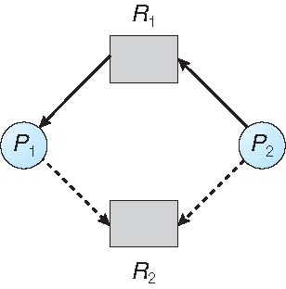
Resource-Allocation Graph

Slide 200
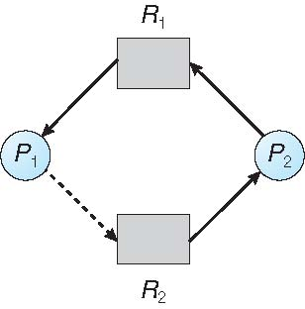
Unsafe State In Resource-Allocation Graph

Slide 201
Resource-Allocation Graph Algorithm
Suppose that process P_{i} requests a resource R_{j}
The request can be granted only if converting the request edge to an assignment edge does not result in the formation of a cycle in the resource allocation graph

Slide 202
Banker’s Algorithm
Multiple instances
Each process must a priori claim maximum use
When a process requests a resource it may have to wait
When a process gets all its resources it must return them in a finite amount of time

Slide 203
Data Structures for the Banker’s Algorithm
Let n = number of processes, and m = number of resources types.
Available: Vector of length m. If available [j] = k, there are k instances of resource type R_{j} available
Max: n x m matrix. If Max [i,j] = k, then process P_{i} may request at most k instances of resource type R_{j}
Allocation: n x m matrix. If Allocation[i,j] = k then P_{i} is currently allocated k instances of R_{j}
Need: n x m matrix. If Need[i,j] = k, then P_{i} may need k more instances of R_{j} to complete its task
Need [i,j] = Max[i,j] – Allocation [i,j]

Slide 204
Safety Algorithm
1. Let Work and Finish be vectors of length m and n, respectively. Initialize:
Work = Available
Finish [i] = false for i = 0, 1, …, n- 1
2. Find an i such that both:
(a) Finish [i] = false
(b) Need_{i} ≤ Work
If no such i exists, go to step 4
3. Work = Work + Allocation_{i} Finish[i] = true go to step 2
4. If Finish [i] == true for all i, then the system is in a safe state

Slide 205
Resource-Request Algorithm for Process P_{i}
Request_{i} = request vector for process P_{i}. If Request_{i} [j] = k then process P_{i} wants k instances of resource type R_{j}
1. If Request_{i} ≤ Need_{i} go to step 2. Otherwise, raise error condition, since process has exceeded its maximum claim
2. If Request_{i} ≤ Available, go to step 3. Otherwise P_{i} must wait, since resources are not available
3. Pretend to allocate requested resources to P_{i} by modifying the state as follows:
Available = Available – Request_{i};
Allocation_{i} = Allocation_{i} + Request_{i};
Need_{i} = Need_{i} – Request_{i};
If safe ⇒ the resources are allocated to P_{i}
If unsafe ⇒ P_{i} must wait, and the old resource-allocation state is restored

Slide 206
Example of Banker’s Algorithm
5 processes P₀ through P₄;
3 resource types:
A (10 instances), B (5instances), and C (7 instances)
Snapshot at time T₀:
Allocation Max Available
A B C A B C A B C
P₀ 0 1 0 7 5 3 3 3 2
P₁ 2 0 0 3 2 2
P₂ 3 0 2 9 0 2
P₃ 2 1 1 2 2 2
P₄ 0 0 2 4 3 3

Slide 207
Example (Cont.)
The content of the matrix Need is defined to be Max – Allocation
Need
A B C
P₀ 7 4 3
P₁ 1 2 2
P₂ 6 0 0
P₃ 0 1 1
P₄ 4 3 1
The system is in a safe state since the sequence < P₁, P₃, P₄, P₂, P₀> satisfies safety criteria

Slide 208
Example: P₁ Request (1,0,2)
Check that Request ≤ Available (that is, (1,0,2) ≤ (3,3,2) ⇒ true
Allocation Need Available
A B C A B C A B C
P₀ 0 1 0 7 4 3 2 3 0
P₁ 3 0 2 0 2 0
P₂ 3 0 2 6 0 0
P₃ 2 1 1 0 1 1
P₄ 0 0 2 4 3 1
Executing safety algorithm shows that sequence < P₁, P₃, P₄, P₀, P₂> satisfies safety requirement
Can request for (3,3,0) by P₄ be granted?
Can request for (0,2,0) by P₀ be granted?

Slide 209
Deadlock Detection
Allow system to enter deadlock state
Detection algorithm
Recovery scheme

Slide 210
Single Instance of Each Resource Type
Maintain wait-for graph
Nodes are processes
P_{i} → P_{j} if P_{i} is waiting for P_{j}
Periodically invoke an algorithm that searches for a cycle in the graph. If there is a cycle, there exists a deadlock
An algorithm to detect a cycle in a graph requires an order of n² operations, where n is the number of vertices in the graph

Slide 211
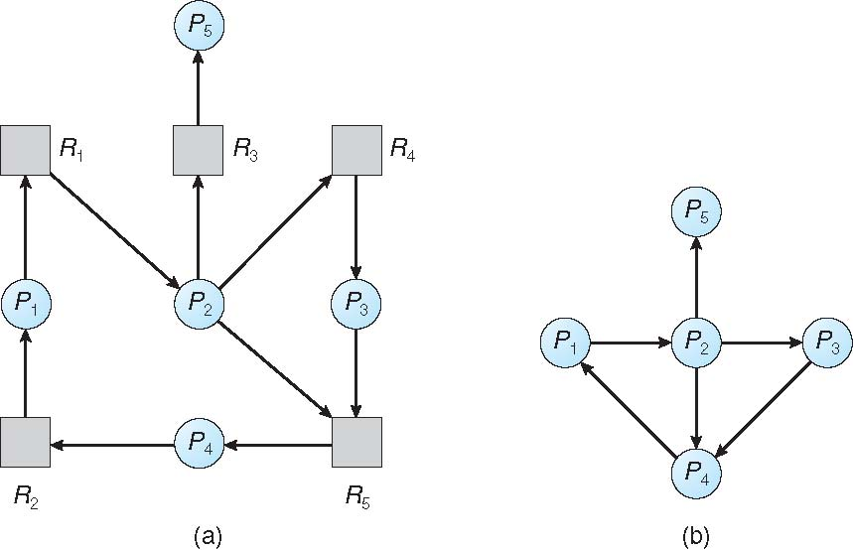
Resource-Allocation Graph and Wait-for Graph
Resource-Allocation Graph
Corresponding wait-for graph

Slide 212
Several Instances of a Resource Type
Available: A vector of length m indicates the number of available resources of each type
Allocation: An n x m matrix defines the number of resources of each type currently allocated to each process
Request: An n x m matrix indicates the current request of each process. If Request [i][j] = k, then process P_{i} is requesting k more instances of resource type R_{j}.

Slide 213
Detection Algorithm
1. Let Work and Finish be vectors of length m and n, respectively Initialize:
(a) Work = Available
(b) For i = 1,2, …, n, if Allocation_{i} ≠ 0, then Finish[i] = false; otherwise, Finish[i] = true
2. Find an index i such that both:
(a) Finish[i] == false
(b) Request_{i} ≤ Work
If no such i exists, go to step 4

Slide 214
Detection Algorithm (Cont.)
3. Work = Work + Allocation_{i} Finish[i] = true go to step 2
4. If Finish[i] == false, for some i, 1 ≤ i ≤ n, then the system is in deadlock state. Moreover, if Finish[i] == false, then P_{i} is deadlocked
Algorithm requires an order of O(m x n²) operations to detect whether the system is in deadlocked state

Slide 215
Example of Detection Algorithm
Five processes P₀ through P₄; three resource types A (7 instances), B (2 instances), and C (6 instances)
Snapshot at time T₀:
Allocation Request Available
A B C A B C A B C
P₀ 0 1 0 0 0 0 0 0 0
P₁ 2 0 0 2 0 2
P₂ 3 0 3 0 0 0
P₃ 2 1 1 1 0 0
P₄ 0 0 2 0 0 2
Sequence <P₀, P₂, P₃, P₁, P₄> will result in Finish[i] = true for all i

Slide 216
Example (Cont.)
P₂ requests an additional instance of type C
Request
A B C
P₀ 0 0 0
P₁ 2 0 2
P₂ 0 0 1
P₃ 1 0 0
P₄ 0 0 2
State of system?
Can reclaim resources held by process P₀, but insufficient resources to fulfill other processes; requests
Deadlock exists, consisting of processes P₁, P₂, P₃, and P₄

Slide 217
Detection-Algorithm Usage
When, and how often, to invoke depends on:
How often a deadlock is likely to occur?
How many processes will need to be rolled back?
one for each disjoint cycle
If detection algorithm is invoked arbitrarily, there may be many cycles in the resource graph and so we would not be able to tell which of the many deadlocked processes “caused” the deadlock.

Slide 218
Recovery from Deadlock: Process Termination
Abort all deadlocked processes
Abort one process at a time until the deadlock cycle is eliminated
In which order should we choose to abort?
Priority of the process
How long process has computed, and how much longer to completion
Resources the process has used
Resources process needs to complete
How many processes will need to be terminated
Is process interactive or batch?

Slide 219
Recovery from Deadlock: Resource Preemption
Selecting a victim – minimize cost
Rollback – return to some safe state, restart process for that state
Starvation – same process may always be picked as victim, include number of rollback in cost factor

Slide 220
End of Chapter 7

